Slide 1
Optimization for Training Deep Models
Lecture slides for Chapter 8 of Deep Learning
www.deeplearningbook.org
Ian Goodfellow
Adapted by m.n. for CMPS 392

Slide 2
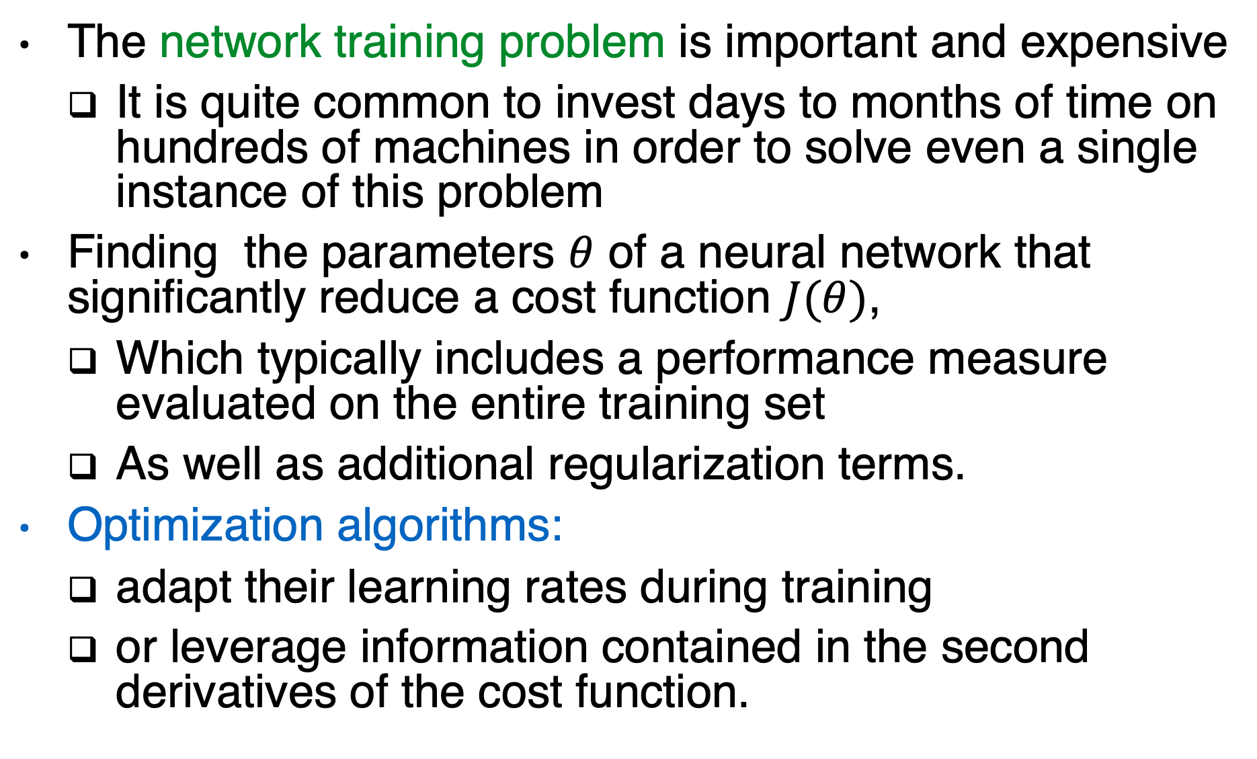
Goal
The network training problem is important and expensive
It is quite common to invest days to months of time on hundreds of machines in order to solve even a single instance of this problem
Finding the parameters $θ$ of a neural network that significantly reduce a cost function $J(θ)$,
Which typically includes a performance measure evaluated on the entire training set
As well as additional regularization terms.
Optimization algorithms:
adapt their learning rates during training
or leverage information contained in the second derivatives of the cost function.

Slide 3
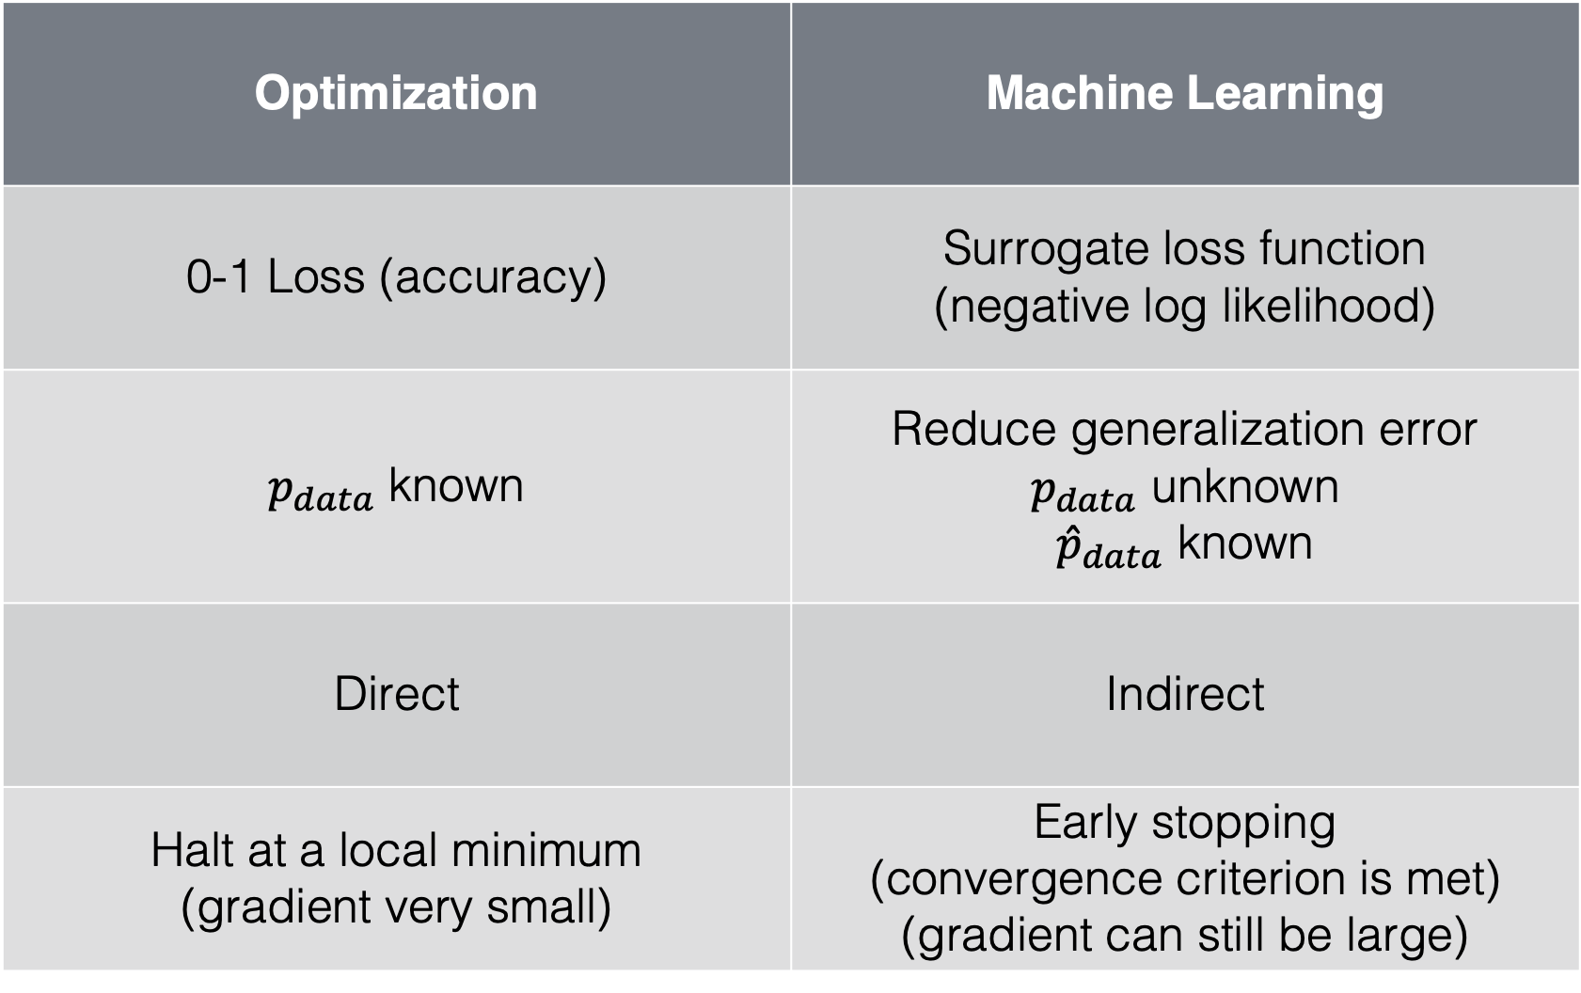
Optimization vs. Machine learning
Optimization | Machine Learning
0-1 Loss (accuracy) | Surrogate loss function (negative log likelihood)
$p_{data}$ known | Reduce generalization error $p_{data}$ unknown ${\hat{p}}_{data}$ known
Direct | Indirect
Halt at a local minimum (gradient very small) | Early stopping (convergence criterion is met) (gradient can still be large)

Slide 4
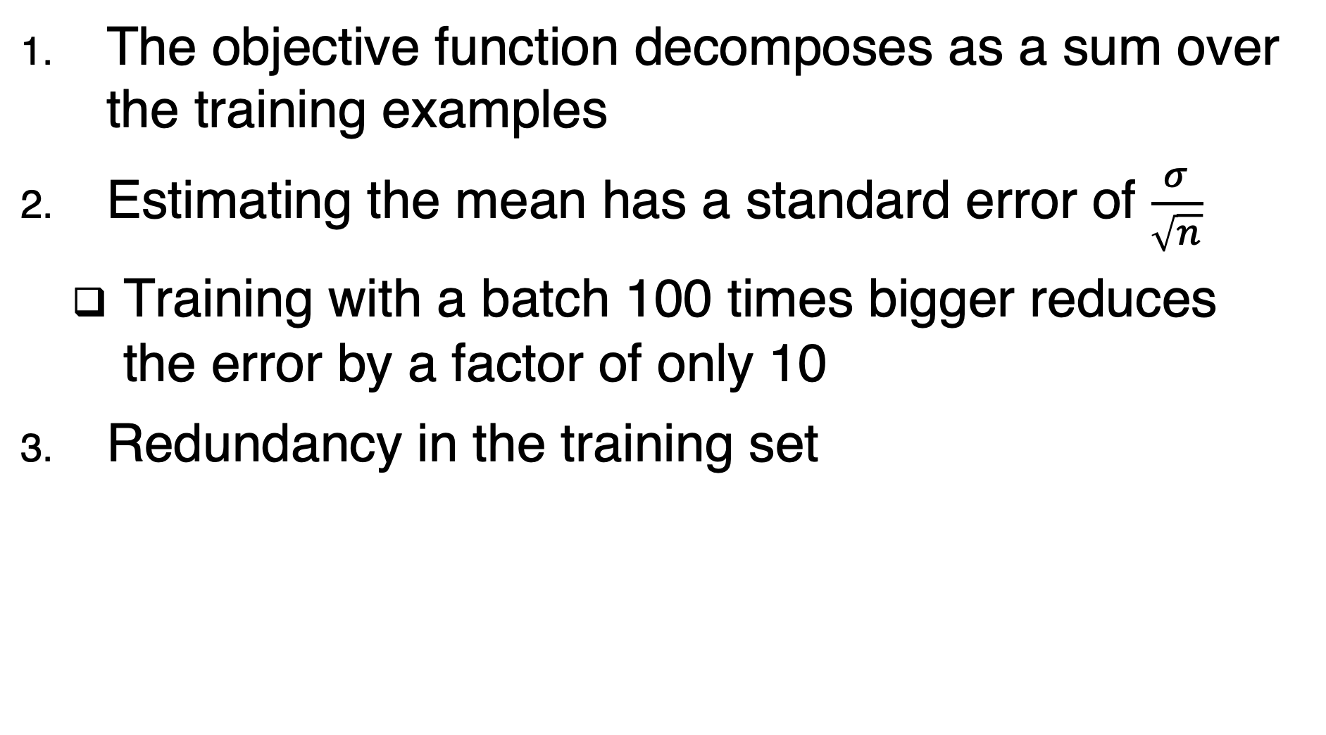
Why Minibatch algorithms?
The objective function decomposes as a sum over the training examples
Estimating the mean has a standard error of $\frac{σ}{\sqrt{n}}$
Training with a batch 100 times bigger reduces the error by a factor of only 10
Redundancy in the training set

Slide 5
What is a good batch size?
Larger batches provide a more accurate estimation fo the gradient, but with less than linear returns
Examples of the batch are typically processed in parallel using multi-core architectures which get under-utilized by small size batches.
For many hardware setups, the limiting factor is most often the memory to store the batch
If using GPUs, it is common for power of 2 batch sizes to offer better runtime (ranging from 32 to 256, 16 for large models)
Small batches can offer a regularization effect
At the cost of a small learning rate to maintain stability
And a large total training runtime
It is also very important to shuffle the data

Slide 6
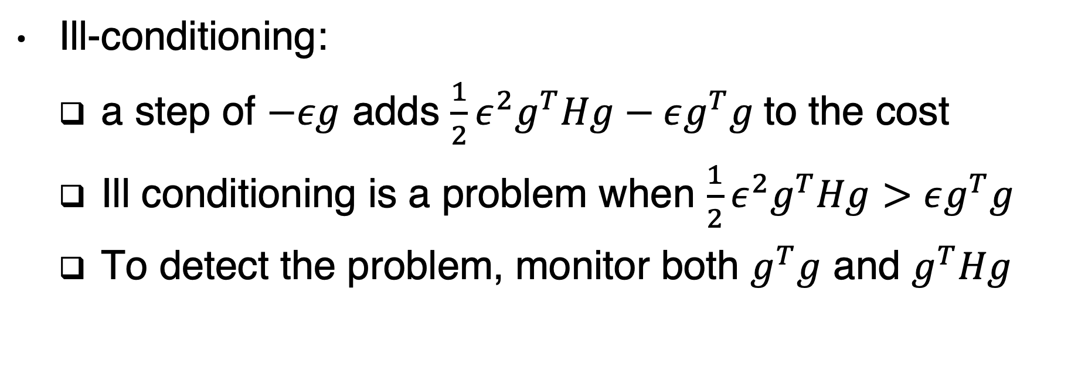
Challenges in Neural Network optimization
Ill-conditioning:
a step of $−εg$ adds $\frac{1}{2}ε^{2}g^{T}Hg−εg^{T}g$to the cost
Ill conditioning is a problem when $\frac{1}{2}ε^{2}g^{T}Hg>εg^{T}g$
To detect the problem, monitor both $g^{T}g$ and $g^{T}Hg$

Slide 7
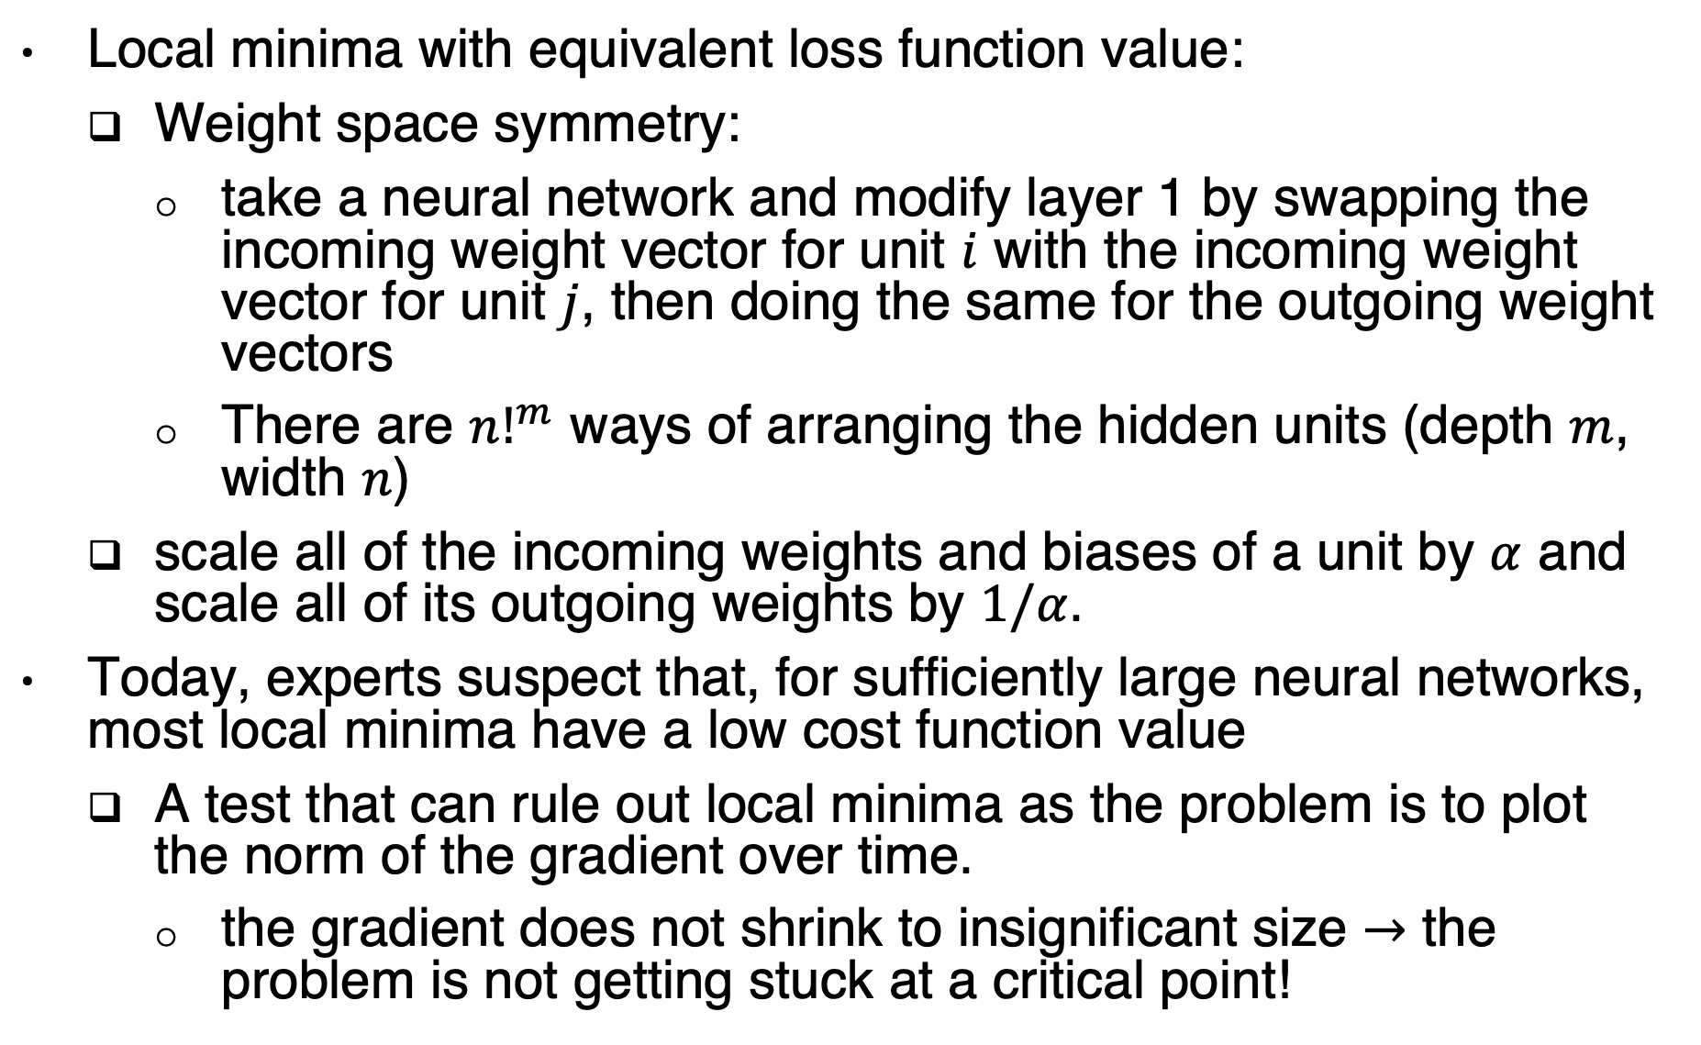
Local minima in neural networks
Local minima with equivalent loss function value:
Weight space symmetry:
take a neural network and modify layer 1 by swapping the incoming weight vector for unit $i$ with the incoming weight vector for unit $j$, then doing the same for the outgoing weight vectors
There are ${n!}^{m}$ ways of arranging the hidden units (depth $m$, width $n$)
scale all of the incoming weights and biases of a unit by $α$ and scale all of its outgoing weights by $1/α$.
Today, experts suspect that, for sufficiently large neural networks, most local minima have a low cost function value
A test that can rule out local minima as the problem is to plot the norm of the gradient over time.
the gradient does not shrink to insignificant size $→$ the problem is not getting stuck at a critical point!

Slide 8
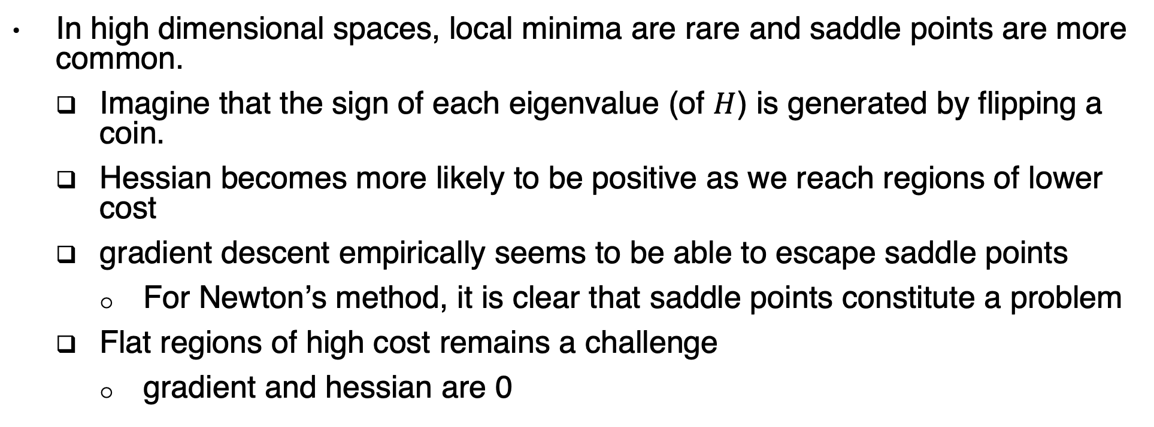
Saddle points
In high dimensional spaces, local minima are rare and saddle points are more common.
Imagine that the sign of each eigenvalue (of $H$) is generated by flipping a coin.
Hessian becomes more likely to be positive as we reach regions of lower cost
gradient descent empirically seems to be able to escape saddle points
For Newton’s method, it is clear that saddle points constitute a problem
Flat regions of high cost remains a challenge
gradient and hessian are 0
gradient descent escaping a saddle point

Slide 9
Cliffs and Exploding Gradients

Slide 10
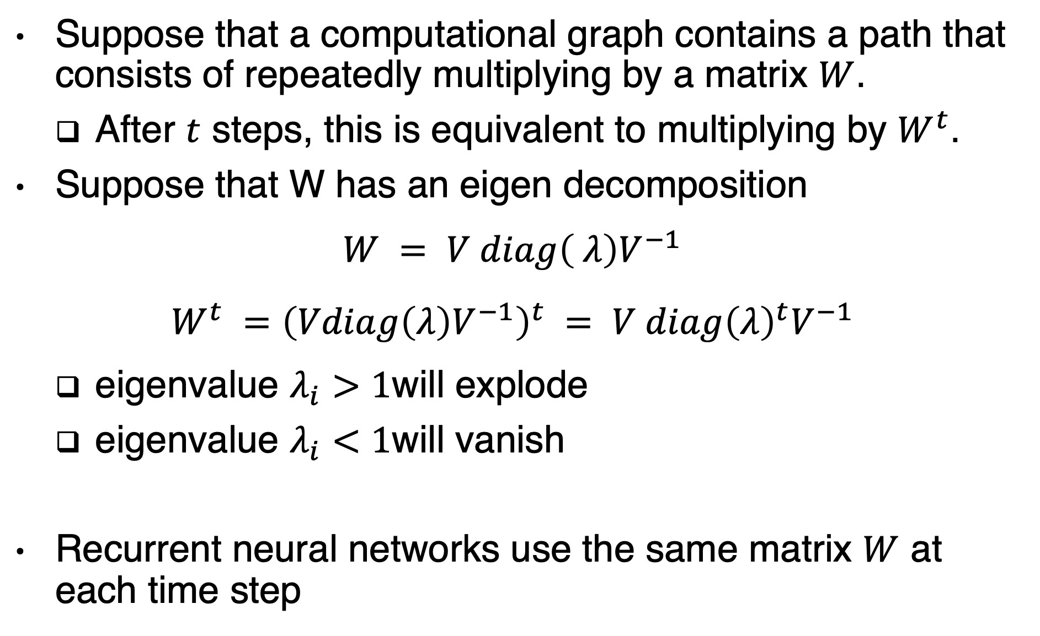
Vanishing and exploding gradient
Suppose that a computational graph contains a path that consists of repeatedly multiplying by a matrix $W$.
After $t$ steps, this is equivalent to multiplying by $W^{t}$.
Suppose that W has an eigen decomposition
$$W = V diag\left( λ\right)V^{−1}$$
$$W^{t} ={\left(Vdiag\left(λ\right)V^{−1}\right)}^{t} = V diag{\left(λ\right)}^{t}V^{−1}$$
eigenvalue $λ_{i}>1$will explode
eigenvalue $λ_{i}<1$will vanish
Recurrent neural networks use the same matrix $W$ at each time step

Slide 11
Poor Correspondence between Local and Global Structure

Slide 12
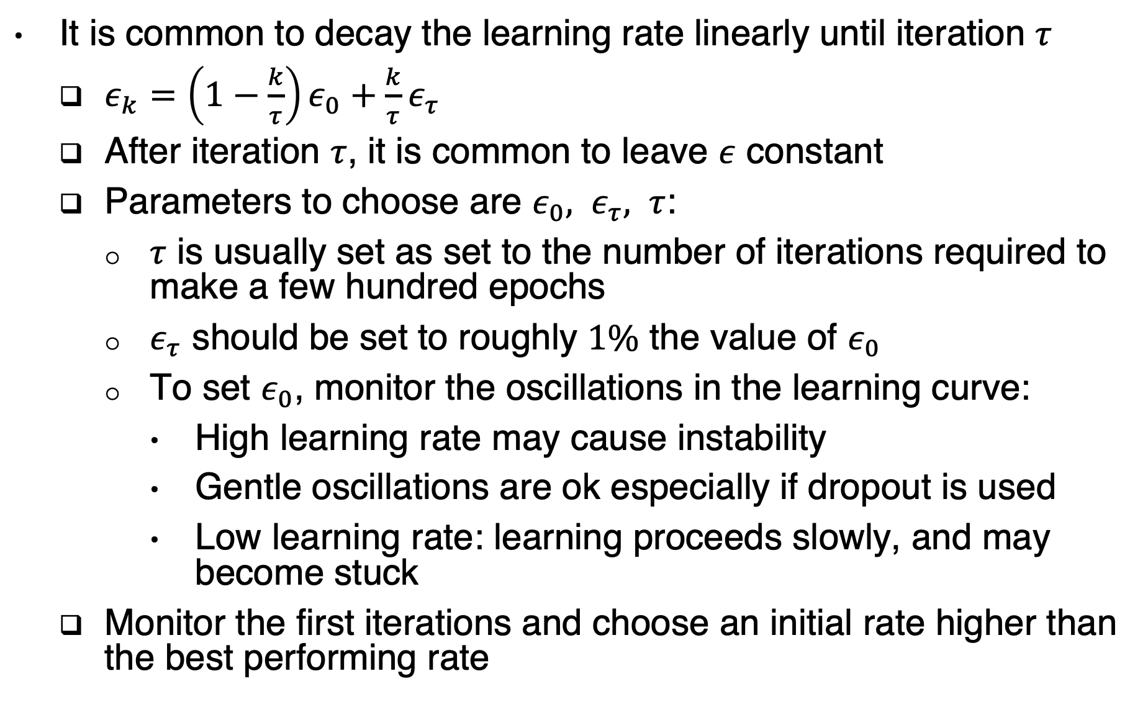
What is a good learning rate?
It is common to decay the learning rate linearly until iteration $τ$
$ε_{k}=\left(1−\frac{k}{τ}\right)ε_{0}+\frac{k}{τ}ε_{τ}$
After iteration $τ$, it is common to leave $ε$ constant
Parameters to choose are $ε_{0}, ε_{τ}, τ$:
$τ$ is usually set as set to the number of iterations required to make a few hundred epochs
$ε_{τ}$ should be set to roughly $1\%$ the value of $ε_{0}$
To set $ε_{0}$, monitor the oscillations in the learning curve:
High learning rate may cause instability
Gentle oscillations are ok especially if dropout is used
Low learning rate: learning proceeds slowly, and may become stuck
Monitor the first iterations and choose an initial rate higher than the best performing rate

Slide 13
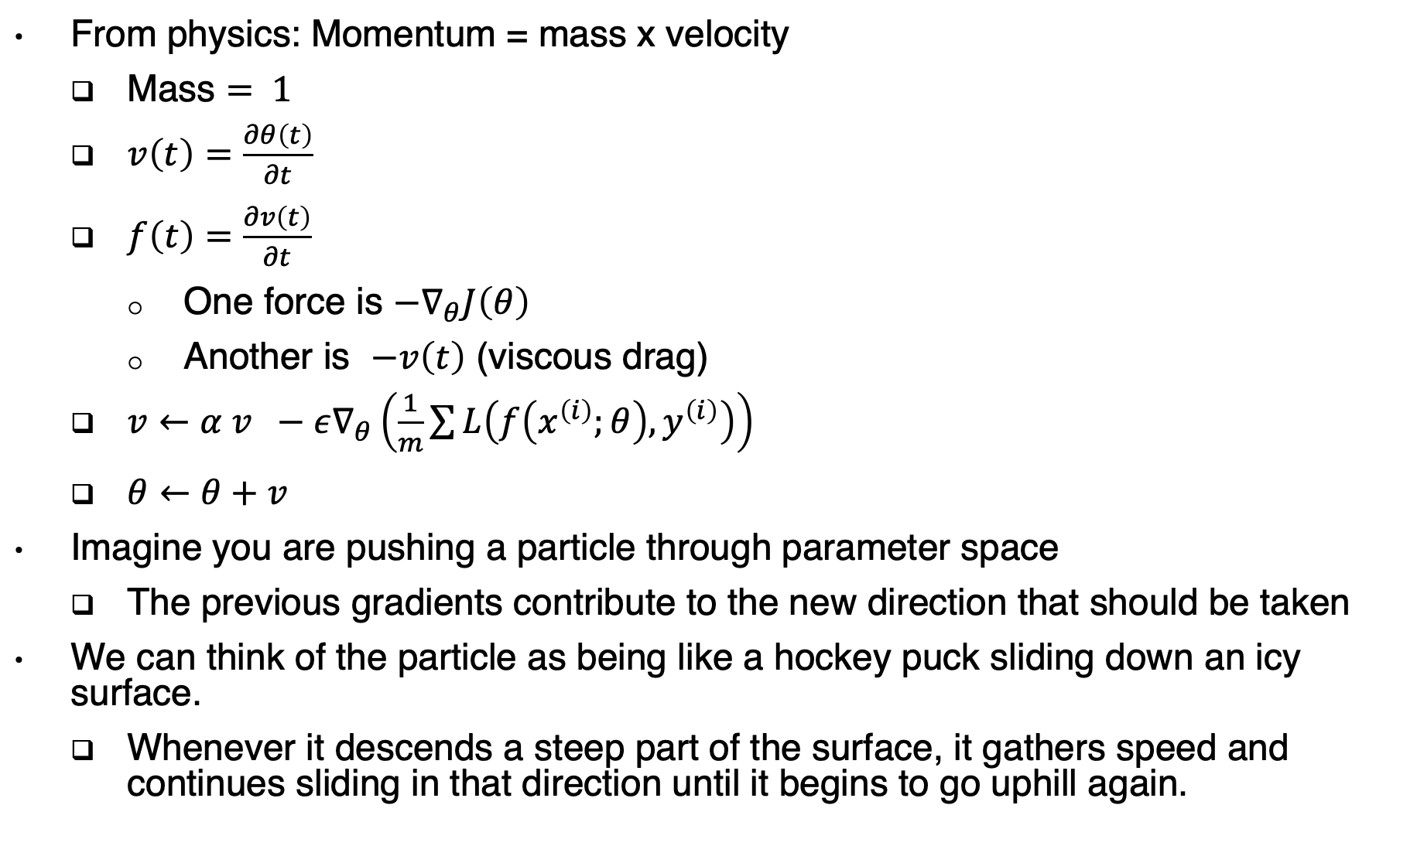
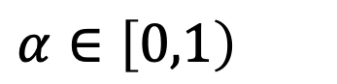
Momentum
From physics: Momentum = mass x velocity
Mass $= 1$
$v\left(t\right)=\frac{∂θ\left(t\right)}{∂t}$
$f\left(t\right)=\frac{∂v\left(t\right)}{∂t}$
One force is $−∇_{θ}J\left(θ\right)$
Another is $−v\left(t\right)$ (viscous drag)
$v←α v −ε∇_{θ}\left(\frac{1}{m}\sum{L\left(f\left(x^{\left(i\right)};θ\right), y^{\left(i\right)}\right)}\right)$
$θ←θ+v$
Imagine you are pushing a particle through parameter space
The previous gradients contribute to the new direction that should be taken
We can think of the particle as being like a hockey puck sliding down an icy surface.
Whenever it descends a steep part of the surface, it gathers speed and continues sliding in that direction until it begins to go uphill again.
$$α∈\left[0,1\right)$$
Notes:
$$α∈\left[0,1\right)$$

Slide 14
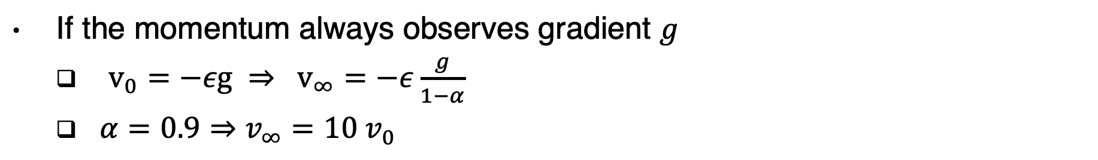
Momentum analysis
If the momentum always observes gradient $g$
$v_{0}=−εg ⇒ v_{∞}=−ε\frac{g}{1−α}$
$α=0.9⇒v_{∞}=10 v_{0}$

Slide 15
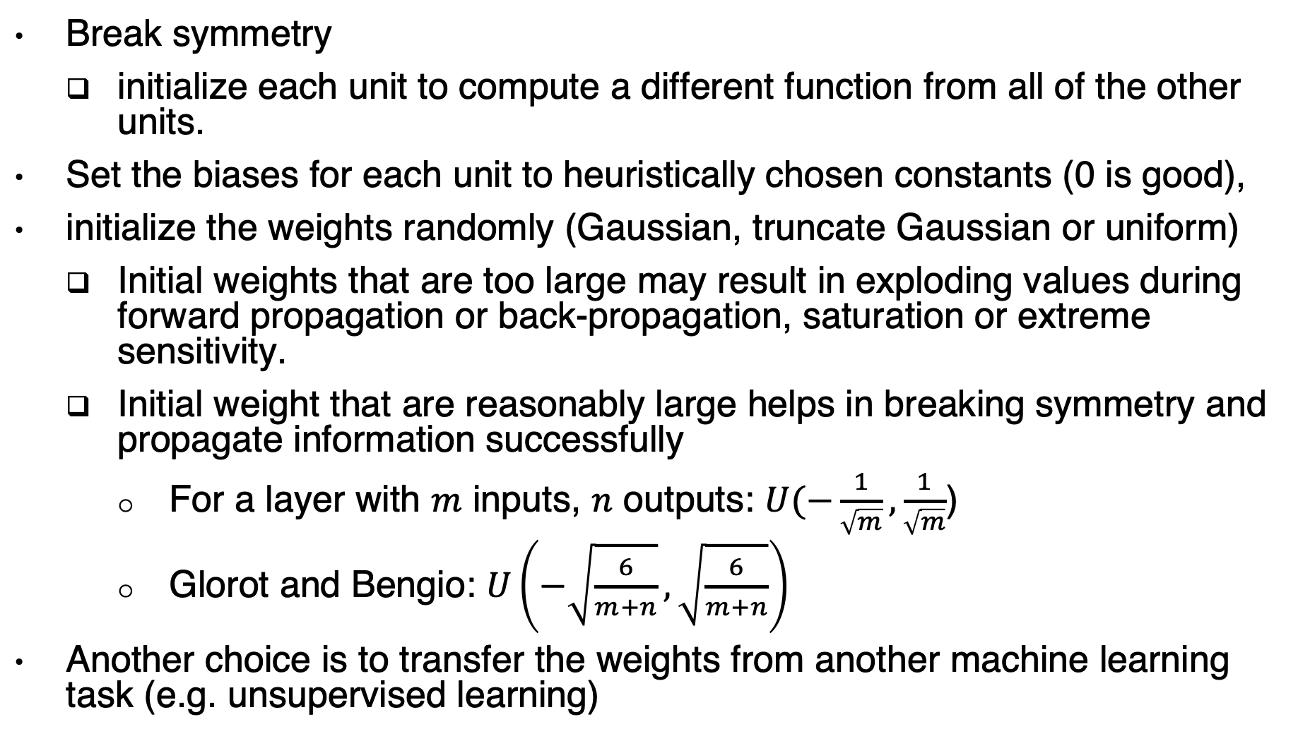
Parameter initialization strategy
Break symmetry
initialize each unit to compute a different function from all of the other units.
Set the biases for each unit to heuristically chosen constants (0 is good),
initialize the weights randomly (Gaussian, truncate Gaussian or uniform)
Initial weights that are too large may result in exploding values during forward propagation or back-propagation, saturation or extreme sensitivity.
Initial weight that are reasonably large helps in breaking symmetry and propagate information successfully
For a layer with $m$ inputs, $n$ outputs: $U(−\frac{1}{\sqrt{m}},\frac{1}{\sqrt{m}}$)
Glorot and Bengio: $U\left(−\sqrt{\frac{6}{m+n}},\sqrt{\frac{6}{m+n}}\right)$
Another choice is to transfer the weights from another machine learning task (e.g. unsupervised learning)

Slide 16
Algorithms with adaptive learning rates
If we believe that the directions of sensitivity are somewhat axis-aligned,
it can make sense to use a separate learning rate for each parameter,
and automatically adapt these learning rates throughout the course of learning.
Example: AdaGrad
Notes:
The parameters with the largest partial derivative of the loss have a correspondingly
rapid decrease in their learning rate, while parameters with small partial derivatives
have a relatively small decrease in their learning rate. The net effect is greater
progress in the more gently sloped directions of parameter space.
AdaGrad performs well for some but not all deep learning
models.

Slide 17
RMSProp (Root Mean Square Propagation)
The RMSProp algorithm (Hinton, 2012) modifies AdaGrad to perform better in the non-convex setting by changing the gradient accumulation into an exponentially weighted moving average.
RMSProp is currently one of the go-to optimization methods being employed routinely by deep learning practitioners

Slide 18
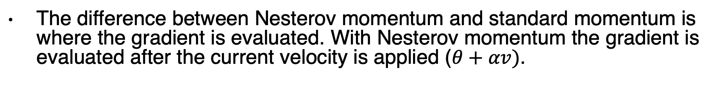
RMSProp with Nesterov momentum
The difference between Nesterov momentum and standard momentum is where the gradient is evaluated. With Nesterov momentum the gradient is evaluated after the current velocity is applied ($θ+αv)$.

Slide 19
Adam (Adaptive Moments)
combination of RMSProp and momentum

Slide 20
Choosing the Right Optimization Algorithm
Currently, the most popular optimization algorithms actively in use include SGD, SGD with momentum, RMSProp, RMSProp with momentum, Adam, and AdaDelta.
The choice depends largely on the user’s familiarity with the algorithm (for ease of hyperparameter tuning)

Slide 21
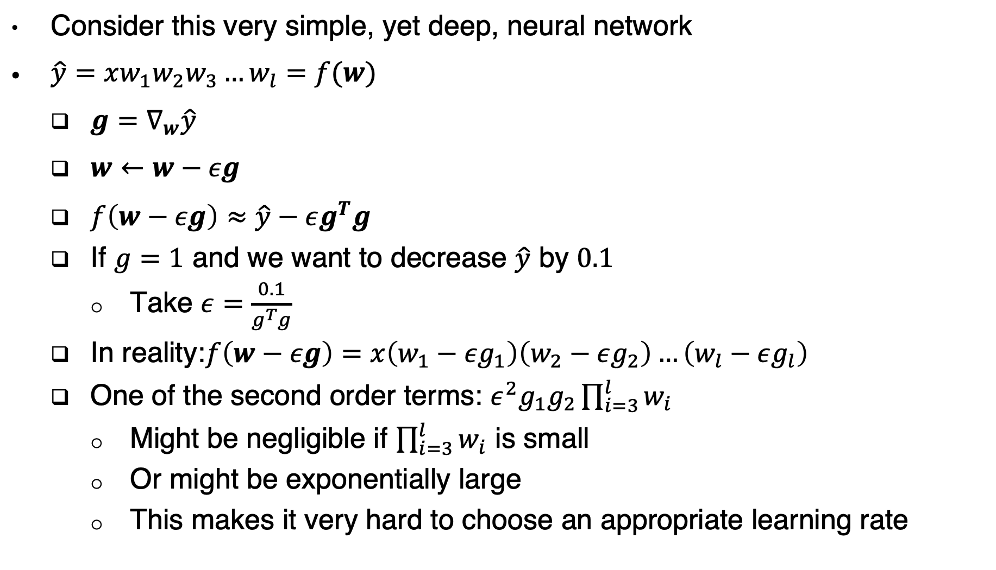
Batch normalization the problem
Consider this very simple, yet deep, neural network
$\hat{y}=xw_{1}w_{2}w_{3}…w_{l}=f(w)$
$g=∇_{w}\hat{y}$
$w←w−εg$
$f\left(w−εg\right)≈\hat{y}−εg^{T}g$
If $g=1$ and we want to decrease $\hat{y}$ by $0.1$
Take $ε=\frac{0.1}{g^{T}g}$
In reality:$f\left(w−εg\right)=x\left(w_{1}−εg_{1}\right)\left(w_{2}−εg_{2}\right)…\left(w_{l}−εg_{l}\right)$
One of the second order terms: $ε^{2}g_{1}g_{2}\prod_{i=3}^{l}{w_{i}}$
Might be negligible if $\prod_{i=3}^{l}{w_{i}}$ is small
Or might be exponentially large
This makes it very hard to choose an appropriate learning rate

Slide 22
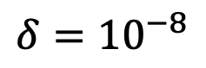
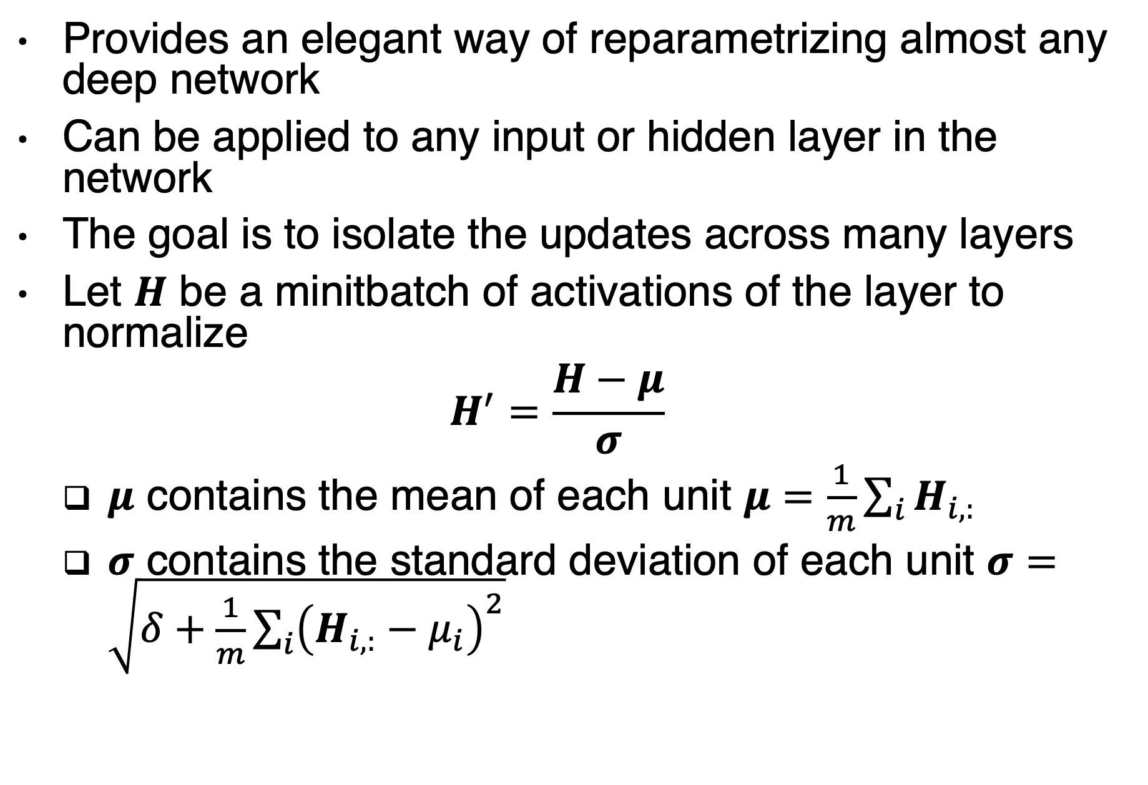
Batch normalization the solution
Provides an elegant way of reparametrizing almost any deep network
Can be applied to any input or hidden layer in the network
The goal is to isolate the updates across many layers
Let $H$ be a minitbatch of activations of the layer to normalize
$$H^{′}=\frac{H−μ}{σ}$$
$μ$ contains the mean of each unit $μ=\frac{1}{m}\sum_{i}{H_{i,:}}$
$σ$ contains the standard deviation of each unit $σ=\sqrt{δ+\frac{1}{m}\sum_{i}{{\left(H_{i,:}−μ_{i}\right)}^{2}}}$
$$δ={10}^{−8}$$

Slide 23
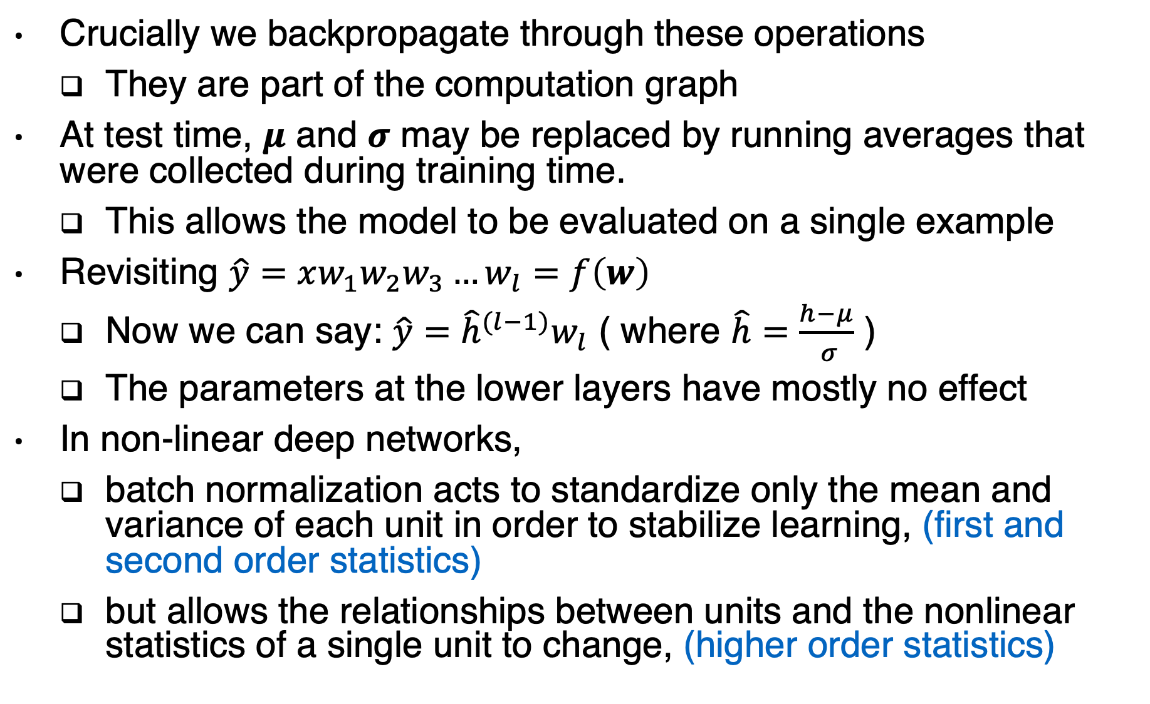
Batch normalization interpretation
Crucially we backpropagate through these operations
They are part of the computation graph
At test time, $μ$ and $σ$ may be replaced by running averages that were collected during training time.
This allows the model to be evaluated on a single example
Revisiting $\hat{y}=xw_{1}w_{2}w_{3}…w_{l}=f\left(w\right)$
Now we can say: $\hat{y}={\hat{h}}^{(l−1)}w_{l}$ ( where $\hat{h}=\frac{h−μ}{ σ}$ )
The parameters at the lower layers have mostly no effect
In non-linear deep networks,
batch normalization acts to standardize only the mean and variance of each unit in order to stabilize learning, (first and second order statistics)
but allows the relationships between units and the nonlinear statistics of a single unit to change, (higher order statistics)

Slide 24
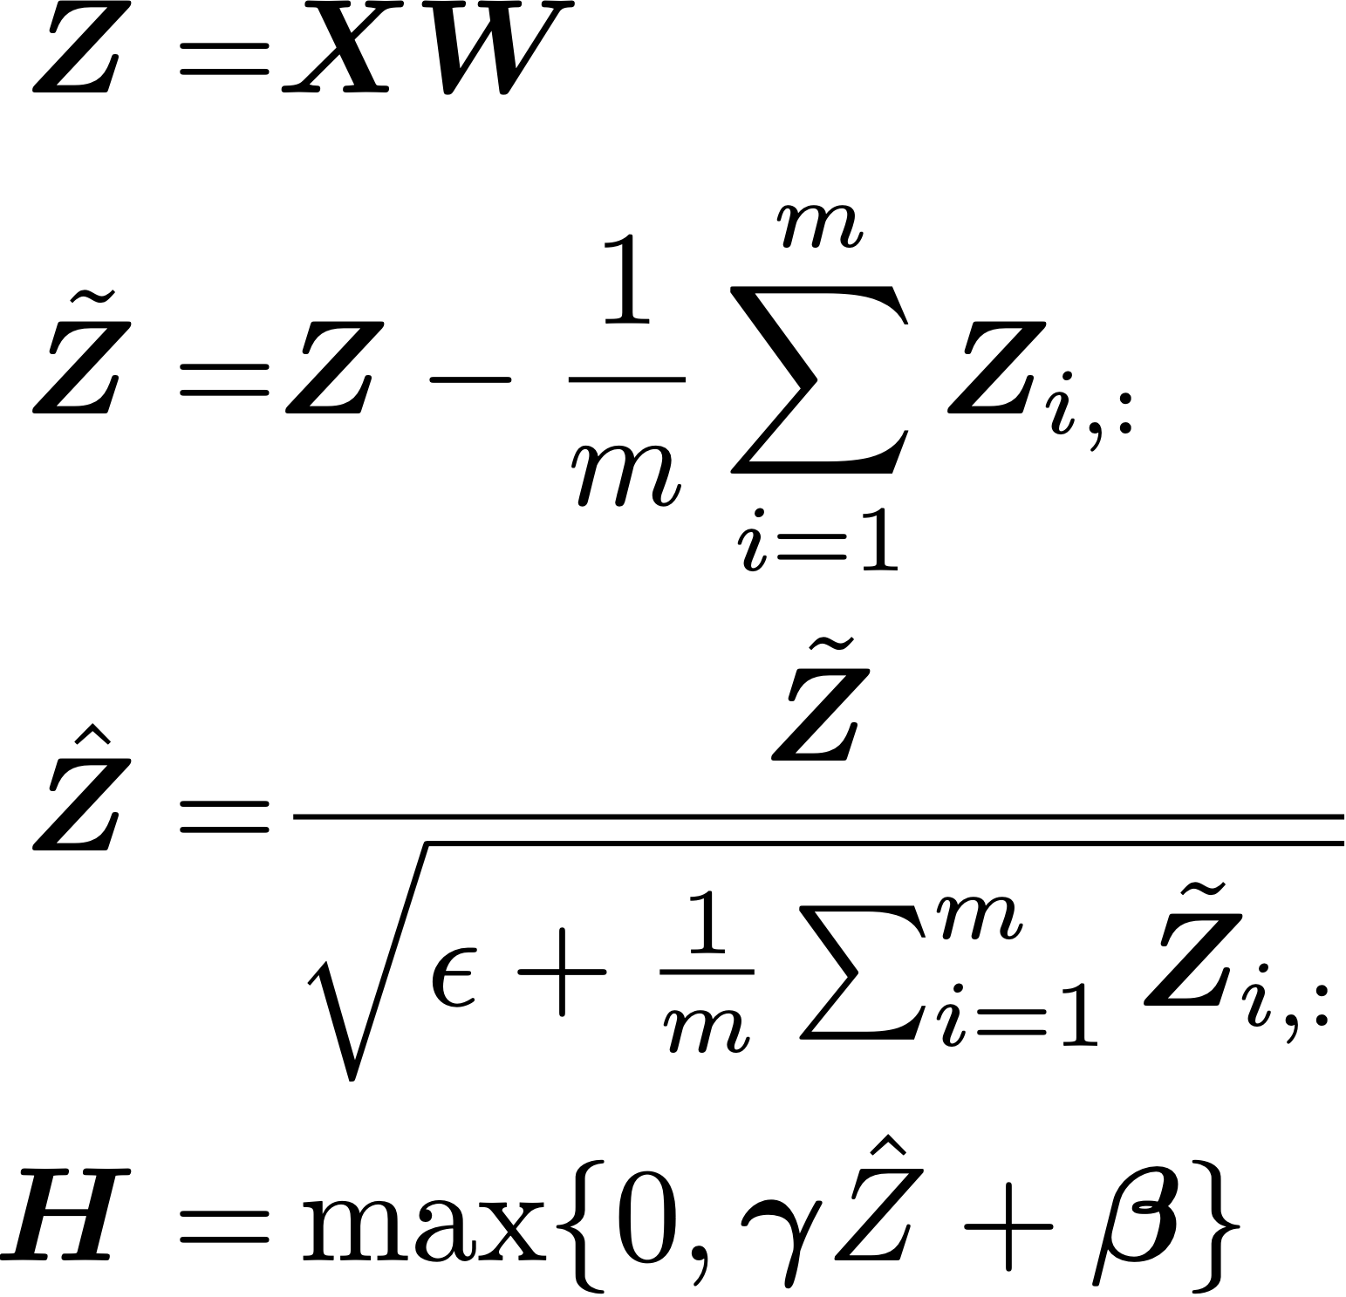
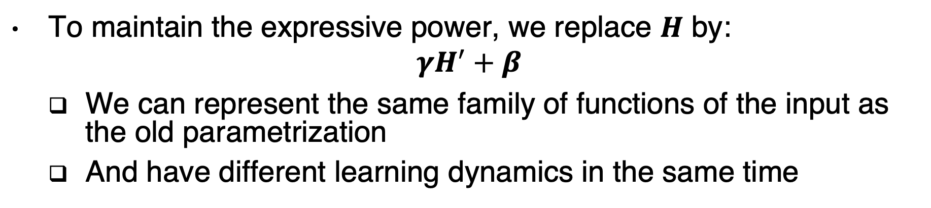
Batch normalization expressive power
To maintain the expressive power, we replace $H$ by:
$$γH^{′}+β$$
We can represent the same family of functions of the input as the old parametrization
And have different learning dynamics in the same time
Checkpoint with
Mean 0,
Stddev 1
2
“Batch Normalization: Accelerating Deep
Network Training by Reducing Internal
Covariate Shift,” Ioffe and Szegedy 2015

Slide 25
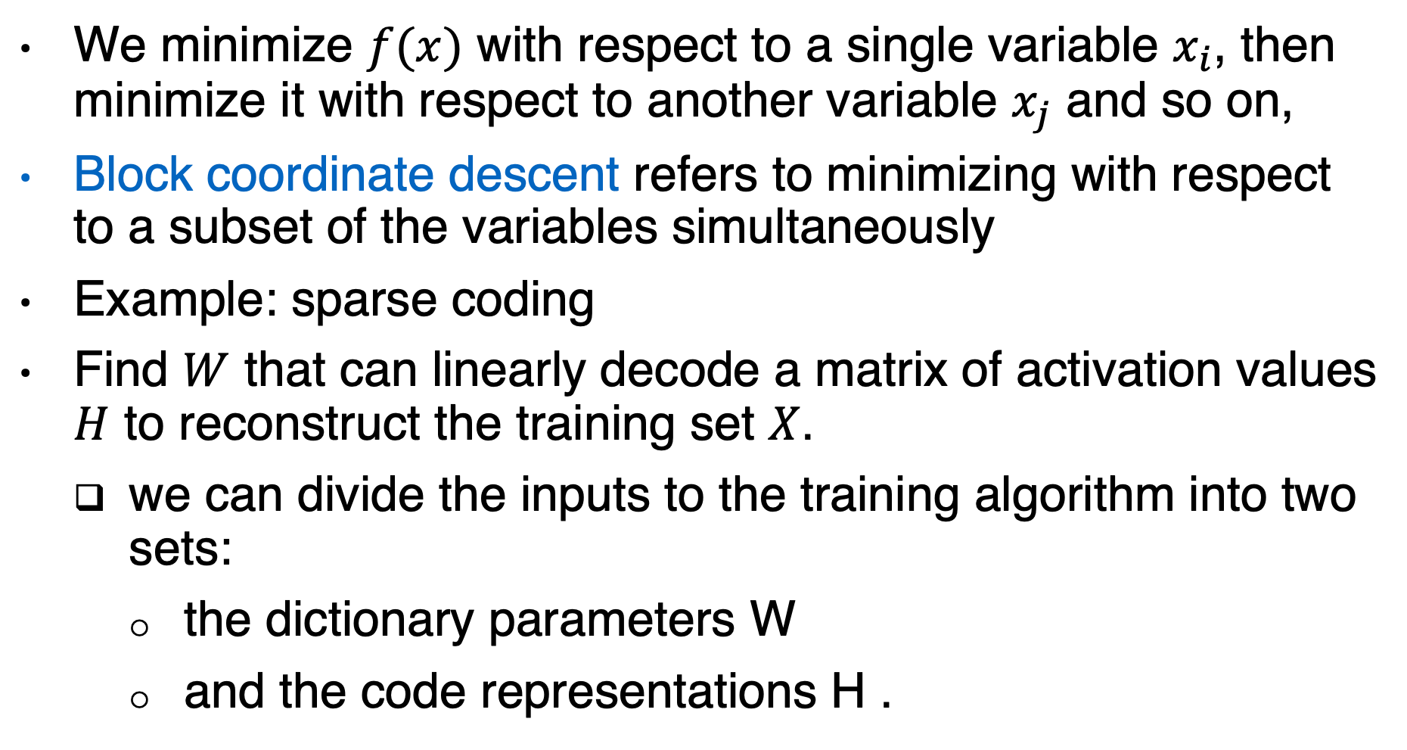
Coordinate descent
We minimize $f(x)$ with respect to a single variable $x_{i}$, then minimize it with respect to another variable $x_{j}$ and so on,
Block coordinate descent refers to minimizing with respect to a subset of the variables simultaneously
Example: sparse coding
Find $W$ that can linearly decode a matrix of activation values $H$ to reconstruct the training set $X$.
we can divide the inputs to the training algorithm into two sets:
the dictionary parameters W
and the code representations H .
Notes:
Block coordinate descent thus gives us an optimization strategy that allows us to use efficient convex optimization
algorithms, by alternating between optimizing W with H fixed, then optimizing H with W fixed.

Slide 26
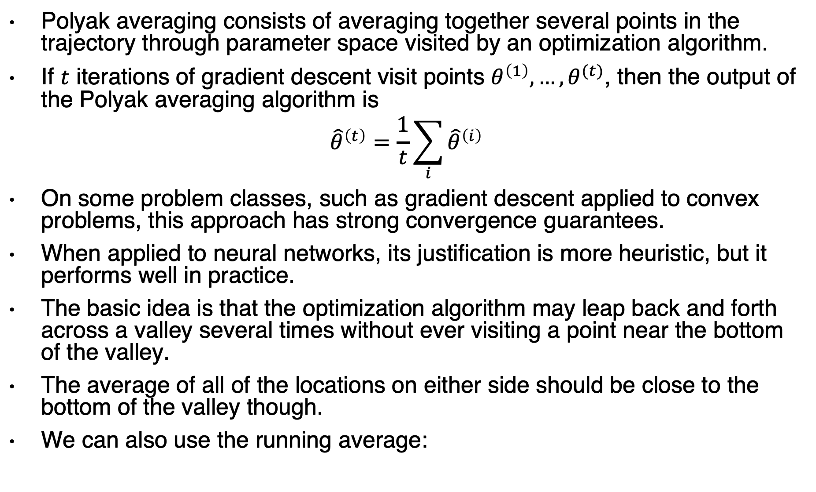
Polyak averaging
Polyak averaging consists of averaging together several points in the trajectory through parameter space visited by an optimization algorithm.
If $t$ iterations of gradient descent visit points $θ^{\left(1\right)}, …, θ^{(t)}$, then the output of the Polyak averaging algorithm is
$${\hat{θ}}^{\left(t\right)}=\frac{1}{t}\sum_{i}{{\hat{θ}}^{\left(i\right)}}$$
On some problem classes, such as gradient descent applied to convex problems, this approach has strong convergence guarantees.
When applied to neural networks, its justification is more heuristic, but it performs well in practice.
The basic idea is that the optimization algorithm may leap back and forth across a valley several times without ever visiting a point near the bottom of the valley.
The average of all of the locations on either side should be close to the bottom of the valley though.
We can also use the running average:

Slide 27
Supervised Pretraining
Pretraining algorithms break supervised learning problems into other simpler supervised learning problems.
Greedy algorithms break a problem into many components, then solve for the optimal version of each component in isolation
Greedy supervised pretraining
We start by training a sufficiently shallow architecture.
Another drawing of the
same architecture
Another drawing of the result, viewed as a feedforward network.
To further improve the optimization, we can jointly fine-tune all the layers, either only at
the end or at each stage of this process
We keep only the input-to-hidden layer of the original network and
discard the hidden-to-output layer. We send the output of the first hidden layer as input to another supervised single hidden layer MLP that is trained with the same objective as the first network was, thus adding a second hidden layer. This can be repeated for as many layers as desired
Notes:
Illustration of one form of greedy supervised pretraining (Bengio et al., 2007).

Slide 28
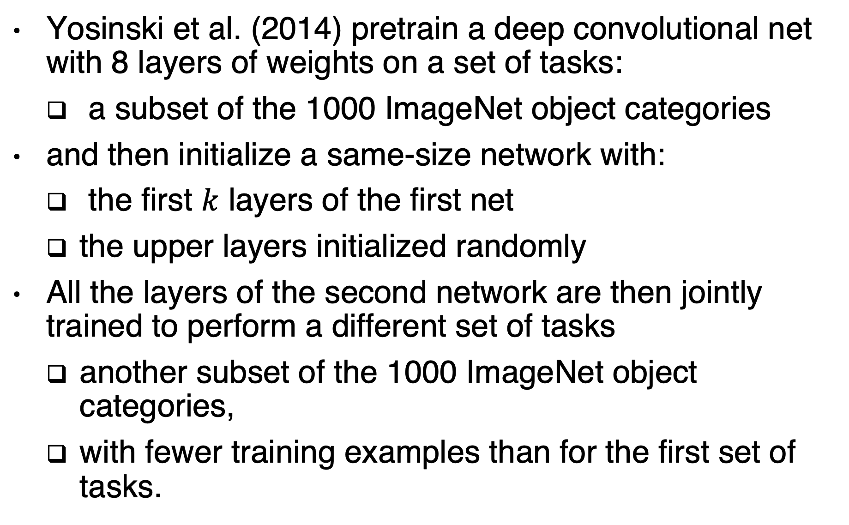
Transfer learning
Yosinski et al. (2014) pretrain a deep convolutional net with 8 layers of weights on a set of tasks:
a subset of the 1000 ImageNet object categories
and then initialize a same-size network with:
the first $k$ layers of the first net
the upper layers initialized randomly
All the layers of the second network are then jointly trained to perform a different set of tasks
another subset of the 1000 ImageNet object categories,
with fewer training examples than for the first set of tasks.

Slide 29
Designing Models to Aid Optimization
It is more important to choose a model family that is easy to optimize than to use a powerful optimization algorithm
Most of the advances in neural network learning over the past 30 years have been obtained by changing the model family rather than changing the optimization procedure
Stochastic gradient descent with momentum, which was used to train neural networks in the 1980s, remains in use in modern state of the art neural network applications.
Specifically, modern neural networks reflect a design choice to use:
linear transformations between layers
and activation functions that are differentiable almost everywhere and have significant slope in large portions of their domain.
Other ideas:
Fitnets: one network is a teacher, the other is a student
skip connections: mitigate the vanishing gradient problem
GoogLeNet: adding extra copies of the output to the intermediate hidden layers of the network, these extra copies are removed after the training

Slide 30
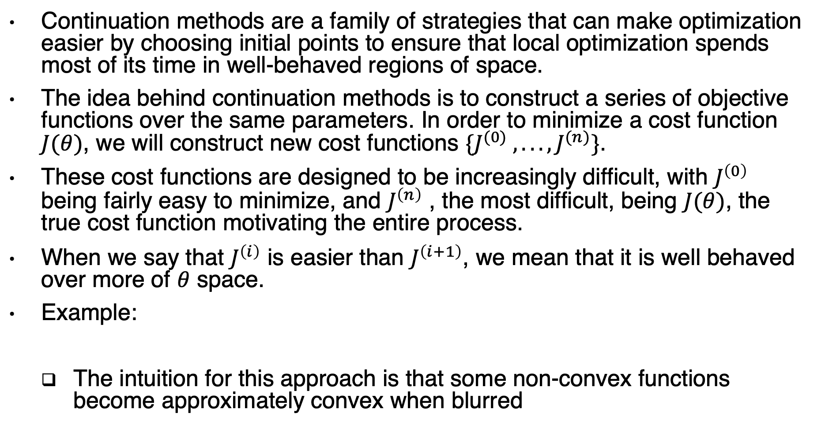
Continuation Methods
Continuation methods are a family of strategies that can make optimization easier by choosing initial points to ensure that local optimization spends most of its time in well-behaved regions of space.
The idea behind continuation methods is to construct a series of objective functions over the same parameters. In order to minimize a cost function $J(θ)$, we will construct new cost functions $\{J^{(0)} , . . . , J^{(n)}\}$.
These cost functions are designed to be increasingly difficult, with $J^{\left(0\right)}$ being fairly easy to minimize, and $J^{\left(n\right)}$ , the most difficult, being $J(θ)$, the true cost function motivating the entire process.
When we say that $J^{\left(i\right)}$ is easier than $J^{\left(i+1\right)}$, we mean that it is well behaved over more of $θ$ space.
Example:
The intuition for this approach is that some non-convex functions become approximately convex when blurred

Slide 31
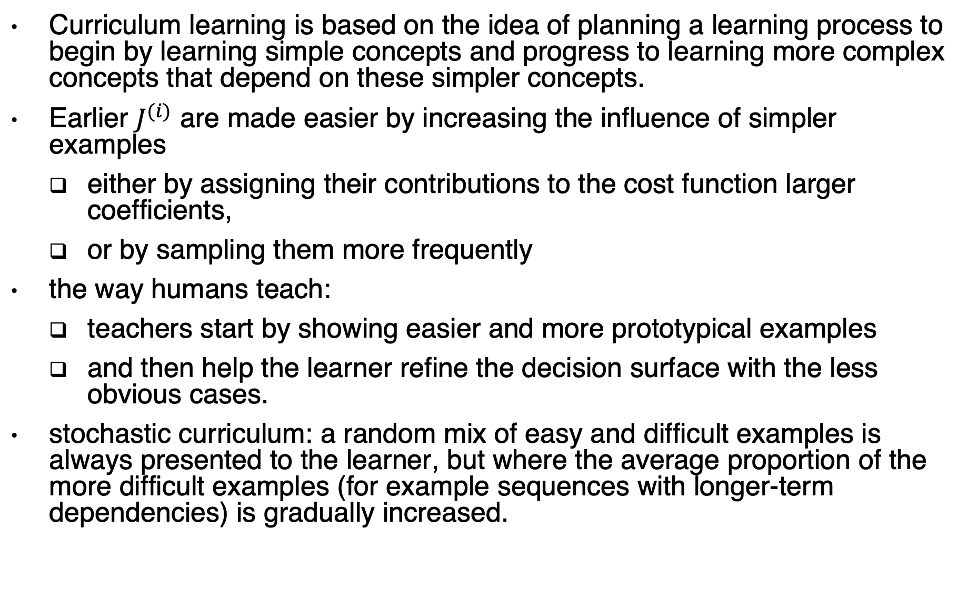
Curriculum learning
Curriculum learning is based on the idea of planning a learning process to begin by learning simple concepts and progress to learning more complex concepts that depend on these simpler concepts.
Earlier $J^{(i)}$ are made easier by increasing the influence of simpler examples
either by assigning their contributions to the cost function larger coefficients,
or by sampling them more frequently
the way humans teach:
teachers start by showing easier and more prototypical examples
and then help the learner refine the decision surface with the less obvious cases.
stochastic curriculum: a random mix of easy and difficult examples is always presented to the learner, but where the average proportion of the more difficult examples (for example sequences with longer-term dependencies) is gradually increased.

Slide 32
Useful links
Ian’s lecture on batch normalization (minutes 3:40 → 13)
https://www.youtube.com/watch?v=Xogn6veSyxA
Series: Optimization (A collection of four posts)
https://blog.paperspace.com/intro-to-optimization-in-deep-learning-gradient-descent/
https://blog.paperspace.com/intro-to-optimization-momentum-rmsprop-adam
https://blog.paperspace.com/vanishing-gradients-activation-function/
https://blog.paperspace.com/busting-the-myths-about-batch-normalization/
ADAM's Story and Proof
https://www.youtube.com/watch?v=n65pElMp6x8
https://www.youtube.com/watch?v=q3zHYfaKg4k

Slide 33
Optional Approximate Second-Order Methods
Newton’s Method
Conjugate Gradients
Non-linear conjugate gradients
Broyden–Fletcher–Goldfarb–Shanno (BFGS) algorithm

Slide 34
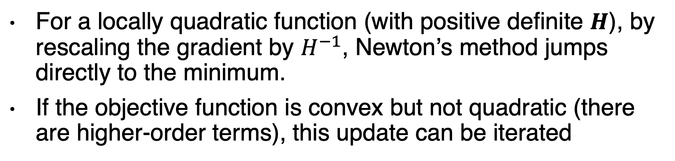
Newton’s method
For a locally quadratic function (with positive definite $H$), by rescaling the gradient by $H^{−1}$, Newton’s method jumps directly to the minimum.
If the objective function is convex but not quadratic (there are higher-order terms), this update can be iterated

Slide 35
Newton’s method algorithm
If the eigenvalues of the Hessian are not
all positive, for example, near a saddle point, then Newton’s method can actually
cause updates to move in the wrong direction. This situation can be avoided
by regularizing the Hessian.

Slide 36
The method of steepest descent

Slide 37
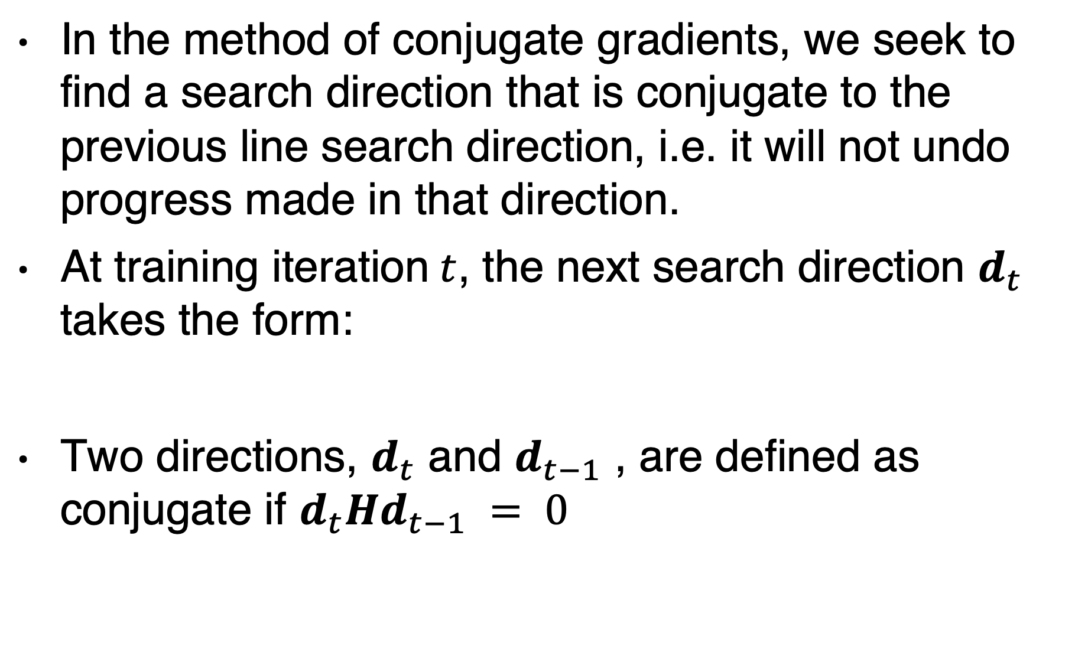
Method of conjugate gradients
In the method of conjugate gradients, we seek to find a search direction that is conjugate to the previous line search direction, i.e. it will not undo progress made in that direction.
At training iteration$t$, the next search direction $d_{t}$ takes the form:
Two directions, $d_{t}$ and $d_{t−1}$ , are defined as conjugate if $d_{t}Hd_{t−1} = 0$

Slide 38
Conjugate gradient algorithm

Slide 39
Nonlinear conjugate gradients
The nonlinear conjugate gradients algorithm includes occasional resets where the method of conjugate gradients is restarted with line search along the unaltered gradient.
Practitioners report reasonable results in applications of the nonlinear conjugate gradients algorithm to training neural networks,
though it is often beneficial to initialize the optimization with a few iterations of stochastic gradient descent before commencing nonlinear conjugate gradients.
Also, while the (nonlinear) conjugate gradients algorithm has traditionally been cast as a batch method, minibatch versions have been used successfully for the training of neural networks

Slide 40
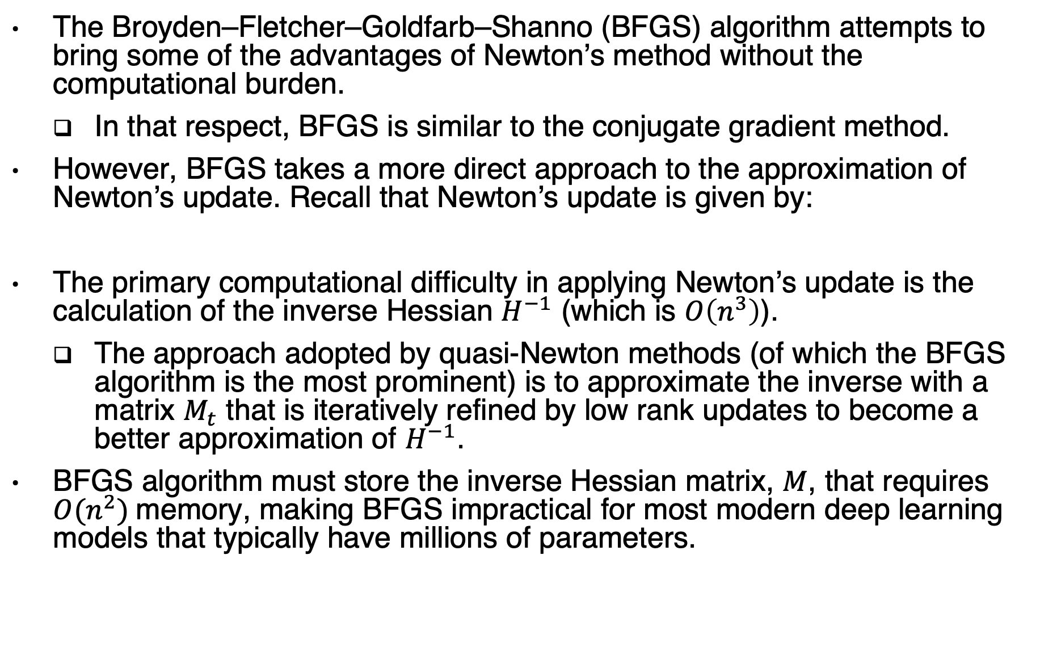
BFGS
The Broyden–Fletcher–Goldfarb–Shanno (BFGS) algorithm attempts to bring some of the advantages of Newton’s method without the computational burden.
In that respect, BFGS is similar to the conjugate gradient method.
However, BFGS takes a more direct approach to the approximation of Newton’s update. Recall that Newton’s update is given by:
The primary computational difficulty in applying Newton’s update is the calculation of the inverse Hessian $H^{−1}$ (which is $O\left(n^{3}\right)$).
The approach adopted by quasi-Newton methods (of which the BFGS algorithm is the most prominent) is to approximate the inverse with a matrix $M_{t}$ that is iteratively refined by low rank updates to become a better approximation of $H^{−1}$.
BFGS algorithm must store the inverse Hessian matrix, $M$, that requires $O(n^{2})$memory, making BFGS impractical for most modern deep learning models that typically have millions of parameters.

